Slide 1

Code developed on small data set, how is it going to scale to the complete data set?
What counts is how the computing time scales as the data becomes larger! That’s by far the dominating factor. We’re interested in order of magnitude.
Development data
Real data
N data points,
Processing time T
10x N data points
Processing time -> ?
Notes:
Data and code are related.
Nice transition from the last question. In extreme case, when the relations in the graph are dynamic/ changing a lot →using a dictionary is not a good solution. Instead, when small dataset and we are mainly interested in visualizing the relations, it might be.
The NumPy array solutions, scales much better, in case there are hundreds of dynamically changing relations to inspect.

Slide 2

NumPy

Slide 3

NumPy – huh, yeah – what’s it good for?
Introduces new data structure: the array
An array is a regular, N-dimensional grid of data of the same type, typically numerical data

Slide 4
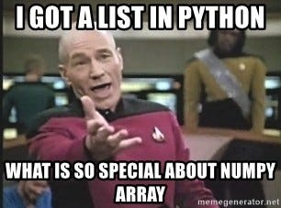
NumPy – huh, yeah – what’s it good for?
Introduces new data structure: the array
An array could be represented as a list-of-lists
Why are NumPy arrays better than a list-of-lists?
**Computer architecture class**
An array is a regular, N-dimensional grid of data of the same type, typically numerical data

Slide 5
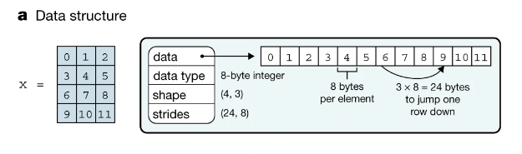
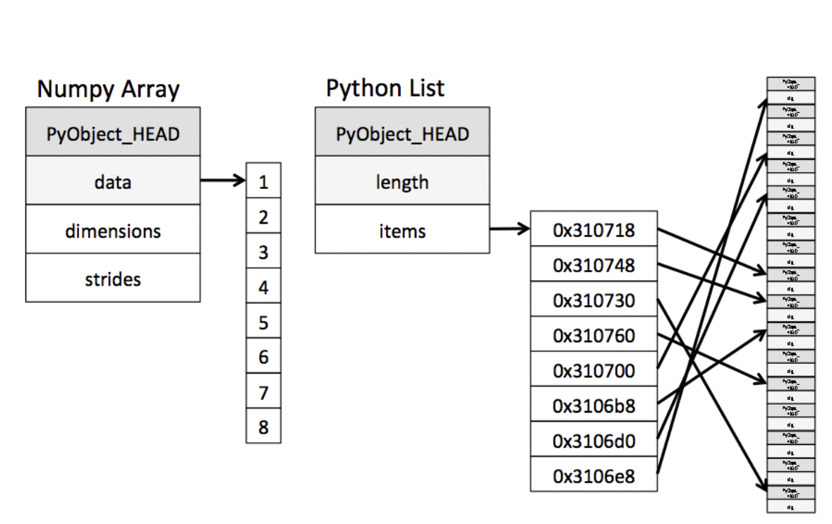
Efficiency of NumPy
Memory:
data occupies the minimum amount of memory required
some operations can be done without touching the memory at all!
Notes:
The standard Python implementation is written in C. This means that every Python object is simply a cleverly-disguised C structure, which contains not only its value, but metadata as well
a C integer is essentially a label for a position in memory whose bytes encode an integer value. A Python integer is a pointer to a position in memory containing all the Python object information, including the bytes that contain the integer value
NumPy handles looping over array elements near-optimally—for example, taking strides into consideration to best utilize the computer’s fast cache memory
Numpy array - single pointer to one contiguous block of data
The Python list, on the other hand, contains a pointer to a block of pointers, each of which in turn points to a full Python object

Slide 6
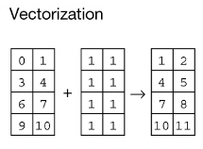
Efficiency of NumPy
Memory:
data occupies the minimum amount of memory required
some operations can be done without touching the memory at all!
Speed:
Many operations can be done very efficiently in C. For this to be useful, we need to avoid Python for-loops at all costs!
operating on entire arrays rather than their individual elements
→ “vectorize” the code
Notes:
Speed
Not only efficient storage of data but also
Numpy package comes with a efficient operations on the data done efficiently in C
Option (usually forced, when using NumPy) to operate on entire arrays rather than on their individual elements

Slide 7


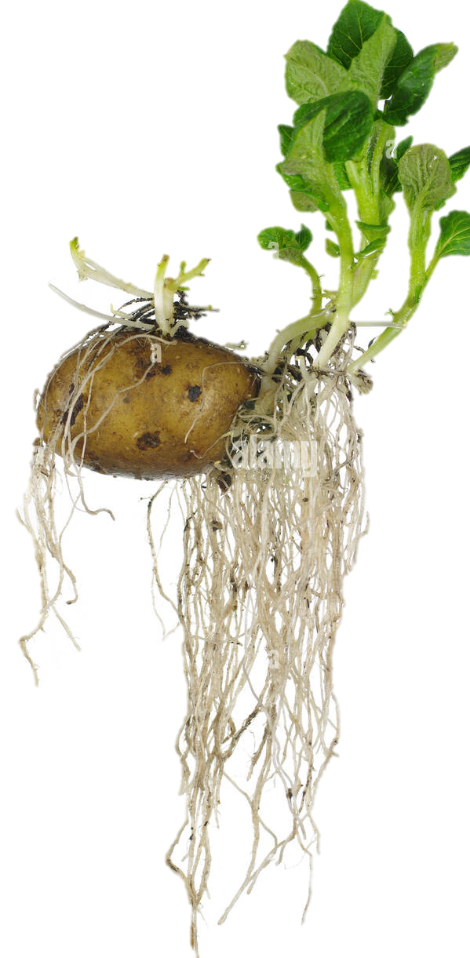

NumPy’s memory efficiency

Slide 8
Memory block
The array data is stored in a contiguous memory block, using native data types
0 | 1 | 2 | 3 | 4 | 5 | 6 | 7 | 8
int64

Slide 9
Memory block
0 | 1 | 2 | 3 | 4 | 5 | 6 | 7 | 8
int64
8 bytes
24 bytes
NumPy array metadata
dtype | int64
ndim | 2
shape | (3, 3)
strides | (24, 8)

Slide 10
Memory block
0 | 1 | 2 | 3 | 4 | 5 | 6 | 7 | 8
Metadata tells NumPy how to interpret the memory block
int64
8 bytes
24 bytes
NumPy array metadata
dtype | int64
ndim | 2
shape | (3, 3)
strides | (24, 8)

Slide 11

Memory block
0 | 1 | 2 | 3 | 4 | 5 | 6 | 7 | 8
Metadata tells NumPy how to interpret the memory block
int64
8 bytes
24 bytes
NumPy array metadata
dtype | int64
ndim | 2
shape | (3, 3)
strides | (24, 8)

Slide 12

Memory block
0 | 1 | 2 | 3 | 4 | 5 | 6 | 7 | 8
Metadata tells NumPy how to interpret the memory block
int64
8 bytes
24 bytes
NumPy array metadata
NumPy view
dtype | int64
ndim | 2
shape | (3, 3)
strides | (24, 8)
0 | 1 | 2
3 | 4 | 5
6 | 7 | 8

Slide 13
Memory block
0 | 1 | 2 | 3 | 4 | 5 | 6 | 7 | 8
The same memory block can be interpreted in many ways
NumPy operation
NumPy view
0 | 1 | 2
3 | 4 | 5
6 | 7 | 8
x
x.ravel()
0 | 1 | 2 | 3 | 4 | 5 | 6 | 7 | 8
0 | 3 | 6
1 | 4 | 7
2 | 5 | 8
x.T
0 | 2
6 | 8
x[::2, ::2]
Notes:
The same memory block can be interpreted in many ways → that means that there are operations that cost nothing because they only change the metadata
Numpy view and operations
Operations that require no time at all because noting is changing , only the metadata
Any operation that only needs to change the metadata. Numpy very efficient
Every time it can, it can only change thet metadata
Operations that can only change the metadata → return a view (introduce new concept)

Slide 14
Memory block
0 | 1 | 2 | 3 | 4 | 5 | 6 | 7 | 8
The same memory block can be interpreted in many ways
NumPy operation
NumPy view
0 | 1 | 2
3 | 4 | 5
6 | 7 | 8
x
x.ravel()
0 | 1 | 2 | 3 | 4 | 5 | 6 | 7 | 8
0 | 3 | 6
1 | 4 | 7
2 | 5 | 8
x.T
0 | 2
6 | 8
x[::2, ::2]
Notes:
The same memory block can be interpreted in many ways → that means that there are operations that cost nothing because they only change the metadata
Numpy view and operations
Operations that require no time at all because noting is changing , only the metadata
Any operation that only needs to change the metadata. Numpy very efficient
Every time it can, it can only change thet metadata
Operations that can only change the metadata → return a view (introduce new concept)

Slide 15
Memory block
0 | 1 | 2 | 3 | 4 | 5 | 6 | 7 | 8
The same memory block can be interpreted in many ways
NumPy operation
NumPy array metadata
NumPy view
dtype | int64
ndim | 2
shape | (3, 3)
strides | (24, 8)
0 | 1 | 2
3 | 4 | 5
6 | 7 | 8
x
dtype | int64
ndim | 1
shape | (9,)
strides | (8,)
x.ravel()
0 | 1 | 2 | 3 | 4 | 5 | 6 | 7 | 8
dtype | int64
ndim | 2
shape | (3, 3)
strides | (8, 24)
0 | 3 | 6
1 | 4 | 7
2 | 5 | 8
x.T
dtype | int64
ndim | 2
shape | (2, 2)
strides | (48, 16)
0 | 2
6 | 8
x[::2, ::2]
Notes:
The same memory block can be interpreted in many ways → that means that there are operations that cost nothing because they only change the metadata
Numpy view and operations
Operations that require no time at all because noting is changing , only the metadata
Any operation that only needs to change the metadata. Numpy very efficient
Every time it can, it can only change thet metadata
Operations that can only change the metadata → return a view (introduce new concept)

Slide 16
Memory block
0 | 1 | 2 | 3 | 4 | 5 | 6 | 7 | 8
There are NumPy operations that can be performed just by changing the metadata
NumPy operation
NumPy array metadata
NumPy view
Preferred &
very efficient --> O(1)
dtype | int64
ndim | 2
shape | (3, 3)
strides | (24, 8)
0 | 1 | 2
3 | 4 | 5
6 | 7 | 8
x
dtype | int64
ndim | 1
shape | (9,)
strides | (8,)
x.ravel()
0 | 1 | 2 | 3 | 4 | 5 | 6 | 7 | 8
dtype | int64
ndim | 2
shape | (3, 3)
strides | (8, 24)
0 | 3 | 6
1 | 4 | 7
2 | 5 | 8
x.T
dtype | int64
ndim | 2
shape | (2, 2)
strides | (48, 16)
0 | 2
6 | 8
x[::2, ::2]
Notes:
The same memory block can be interpreted in many ways → that means that there are operations that cost nothing because they only change the metadata
Numpy view and operations
Operations that require no time at all because noting is changing , only the metadata
Any operation that only needs to change the metadata. Numpy very efficient
Every time it can, it can only change thet metadata
Operations that can only change the metadata → return a view (introduce new concept)

Slide 17
Memory block
0 | 1 | 2 | 3 | 4 | 5 | 6 | 7 | 8
The same memory block can be interpreted in many ways
NumPy operation
NumPy array metadata
NumPy view
dtype | int64
ndim | 2
shape | (3, 3)
strides | (24, 8)
0 | 1 | 2
3 | 4 | 5
6 | 7 | 8
x
There are NumPy operations that can be performed just by changing the metadata
→ preferred and
→ O(1) – very efficient
dtype | int64
ndim | 1
shape | (9,)
strides | (8,)
x.ravel()
0 | 1 | 2 | 3 | 4 | 5 | 6 | 7 | 8
dtype | int64
ndim | 2
shape | (3, 3)
strides | (8, 24)
0 | 3 | 6
1 | 4 | 7
2 | 5 | 8
x.T
dtype | int64
ndim | 2
shape | (2, 2)
strides | (48, 16)
0 | 2
6 | 8
x[::2, ::2]
Notes:
Mid conclusion slide. Ha eto decide to keep this one or the one before.

Slide 18
Memory block
0 | 1 | 2 | 3 | 4 | 5 | 6 | 7 | 8
The same memory block can be interpreted in many ways
NumPy operation
NumPy array metadata
NumPy view
dtype | int64
ndim | 2
shape | (3, 3)
strides | (24, 8)
0 | 1 | 2
3 | 4 | 5
6 | 7 | 8
x
dtype | int64
ndim | 1
shape | (9,)
strides | (8,)
x.ravel()
0 | 1 | 2 | 3 | 4 | 5 | 6 | 7 | 8
How does the metadata look in this case?
dtype
ndim
shape
strides
x[[0,1,2], [1,0,1]]
1 | 3 | 7
Notes:
The same memory block can be interpreted in many ways → that means that there are operations that cost nothing because they only change the metadata
Numpy view and operations
Operations that require no time at all because noting is changing , only the metadata
Any operation that only needs to change the metadata. Numpy very efficient
Every time it can, it can only change thet metadata
Operations that can only change the metadata → return a view (introduce new concept)

Slide 19
Memory block
0 | 1 | 2 | 3 | 4 | 5 | 6 | 7 | 8
The same memory block can be interpreted in many ways
NumPy operation
NumPy array metadata
NumPy view
dtype | int64
ndim | 2
shape | (3, 3)
strides | (24, 8)
0 | 1 | 2
3 | 4 | 5
6 | 7 | 8
x
dtype | int64
ndim | 1
shape | (9,)
strides | (8,)
x.ravel()
0 | 1 | 2 | 3 | 4 | 5 | 6 | 7 | 8
sometimes new memory needs to get involved
Another memory block
How does the metadata look in this case?
1 | 3 | 7
dtype | int64
ndim | 1
shape | (3,)
strides | (8,)
x[[0,1,2], [1,0,1]]
1 | 3 | 7
Notes:
The same memory block can be interpreted in many ways → that means that there are operations that cost nothing because they only change the metadata
Numpy view and operations
Operations that require no time at all because noting is changing , only the metadata
Any operation that only needs to change the metadata. Numpy very efficient
Every time it can, it can only change thet metadata
Operations that can only change the metadata → return a view (introduce new concept)

Slide 20

Operations that only change the metadata return a view, otherwise a new memory block needs to be allocated and they return a copy
Image of how food can be viewed through a kaleidoscope
Say Something about what they could do with this knowedge about bviews and copys
Live Coding
notebooks/numpy/numpy_views_and_copies.ipynb

Slide 21

Operations that only change the metadata return a view, otherwise a new memory block needs to be allocated and they return a copy
Image of how food can be viewed through a kaleidoscope
Say Something about what they could do with this knowledge about views and copys
Live Coding
Exercise
notebooks/numpy/numpy_views_and_copies.ipynb
exercises/view_or_copy/view_or_copy.ipynb

Slide 22
A special kind of view: broadcasting operations
Memory block
0 | 1 | 2 | 3 | 4 | 5 | 6 | 7 | 8
NumPy array metadata
dtype | int64
ndim | 2
shape | (4, 9)
strides | (0, 8)
The shape says we have 4 rows and 9 columns
A stride of 0 means that for each new row, we don’t move in memory
Notes:
Special case, when one of the strides is 0 → duplicates without occupying more memory
Transition, other operations that can

Slide 23
A special kind of view: broadcasting operations
Memory block
As a result, we obtain a view with duplicated rows, without using extra memory!
0 | 1 | 2 | 3 | 4 | 5 | 6 | 7 | 8
NumPy array metadata
NumPy view
dtype | int64
ndim | 2
shape | (4, 9)
strides | (0, 8)
The shape says we have 4 rows and 9 columns
0 | 1 | 2 | 3 | 4 | 5 | 6 | 7 | 8
0 | 1 | 2 | 3 | 4 | 5 | 6 | 7 | 8
0 | 1 | 2 | 3 | 4 | 5 | 6 | 7 | 8
0 | 1 | 2 | 3 | 4 | 5 | 6 | 7 | 8
A stride of 0 means that for each new row, we don’t move in memory
Notes:
Stride == 0 → then we are not actually moving in memory, same memory, we are looping over the same thing

Slide 24
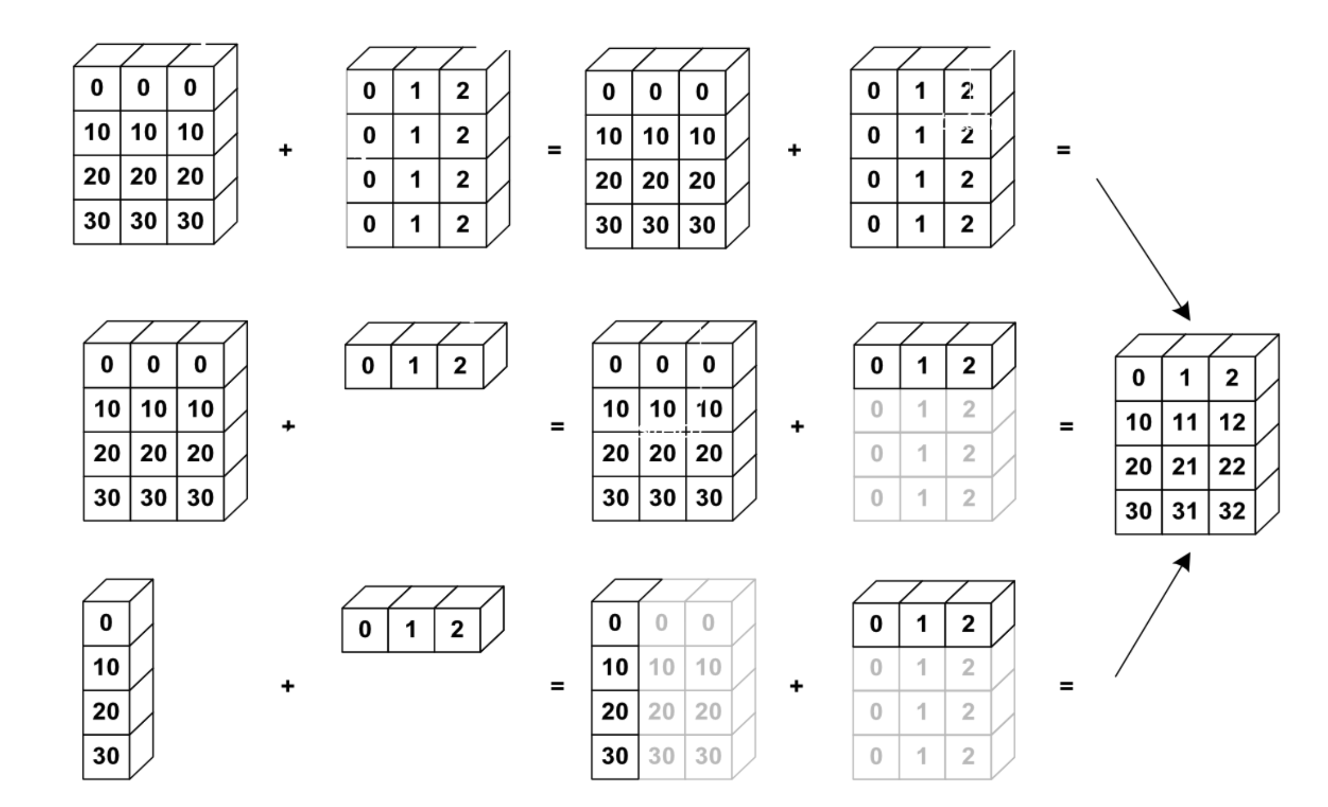
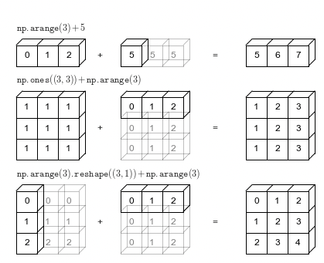
NumPy uses broadcasting to perform operation on arrays of different shape without having to allocate extra memory

Slide 25
NumPy uses broadcasting to perform operation on arrays of different shape without having to allocate extra memory
Live Coding
notebooks/numpy/broadcasting.ipynb

Slide 26
Rules of Broadcasting
SKIP
1: If the two arrays differ in their number of dimensions, the shape of the one with fewer dimensions is padded with ones on its leading (left) side.
2: If the shape of the two arrays does not match in any dimension, the array with shape equal to 1 in that dimension is stretched to match the other shape.
3: If in any dimension the sizes disagree and neither is equal to 1, an error is raised.
Notes:
Show 1,2 examples and the notebook with the rules/ their implementation

Slide 27



NumPy’s speed efficiency

Slide 28
Vectorization
operations can be performed on entire arrays at once, rather than looping through each element individually
→ Faster computation
Element-wise operations
Addition
Multiplication by a scalar
Vector dot product
Matrix multiplication
Advanced
concatenate(), hstack(), vstack()
sort()
where()
median(), sum(), mean()

Slide 29
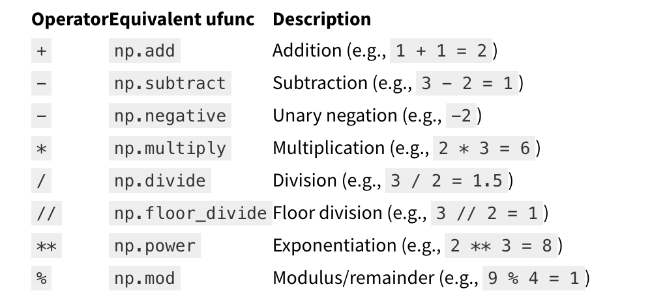
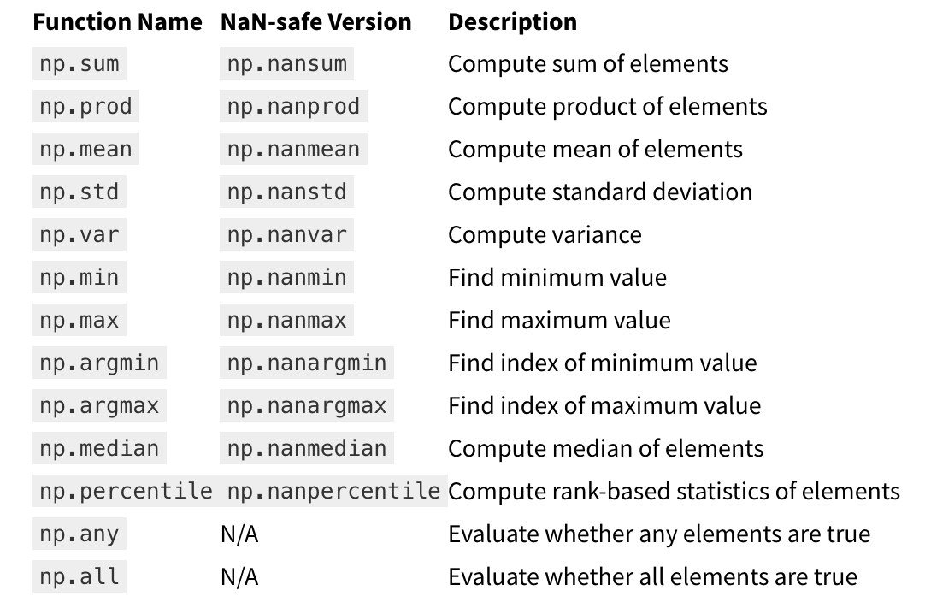
Ufuncs Aggregation functions
SKIP

Slide 30
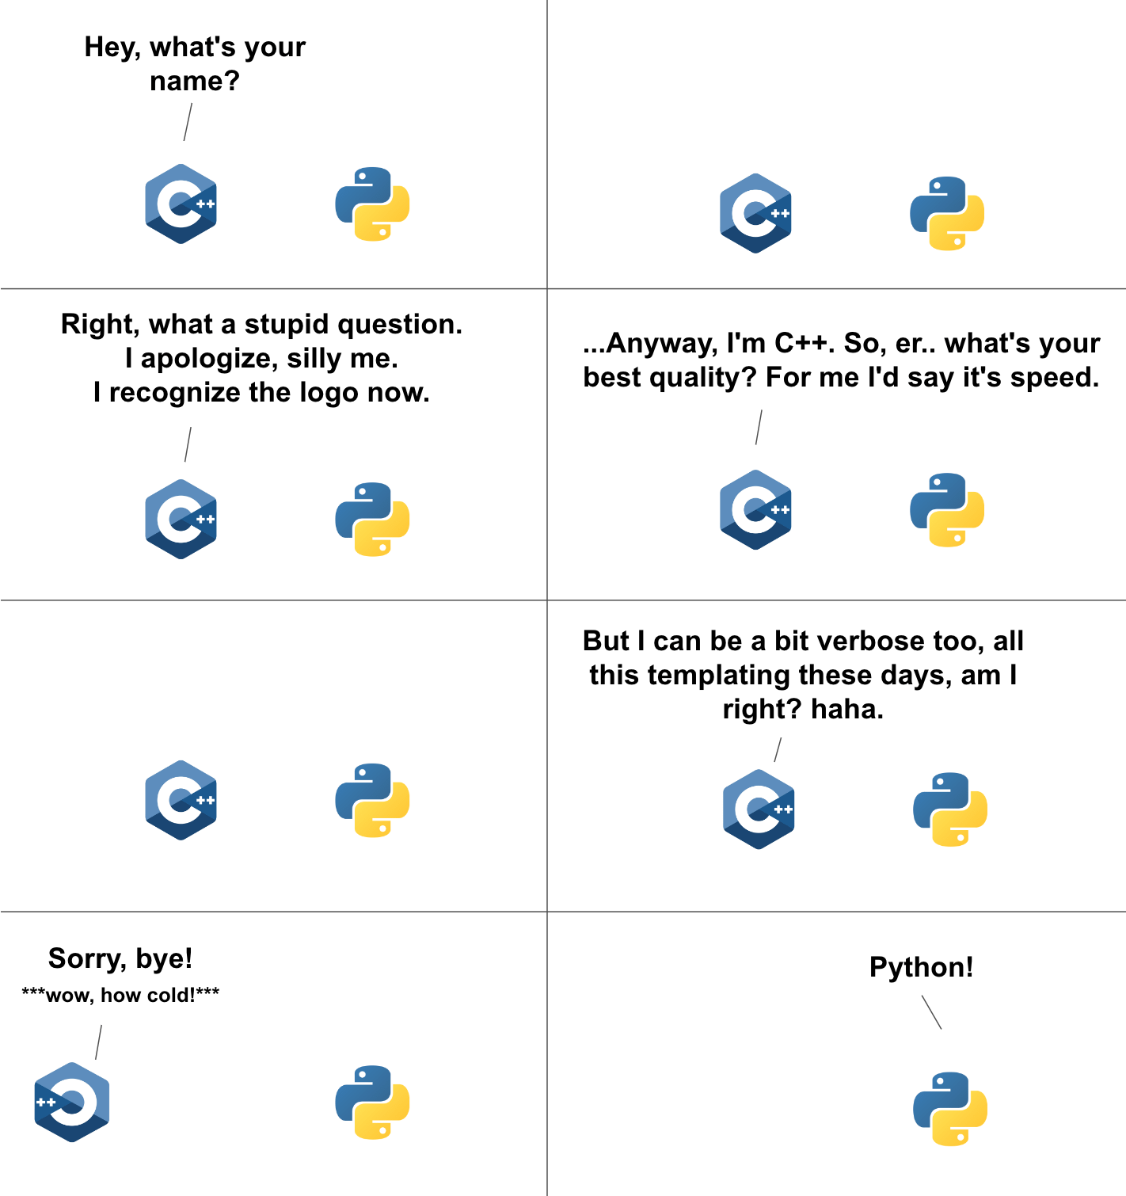
For-loops in Python vs in C
Data is of a C numerical type → regular layout in memory.
A C loop can jump from one memory location to the next by moving by “strides” bytes and accumulating the result
To get that performance, one needs to vectorize! it’s important to avoid for-loops at all costs (with NumPy in Python)
How is efficiency of Python vs C in the Big-O sense?
Notes:
`
a = x[::2, 3]
a.sum()
start_memory_pos = a.data
a.dtype sum = 0
for i in a.shape[0]:
for j in a.shape[1]:
memory_pos = start_memory_pos + a.strides[0] * i + a.strides[1] * j
sum += cast_to(memory_pos, a.dtype)

Slide 31
Exercise: vectorize the code
Live Coding
notebooks/numpy/
vectorize.ipynb

Slide 32
Exercise: vectorize the code
Live Coding
Exercise
notebooks/numpy/
vectorize.ipynb
exercises/numpy_vectorize / numpy_vectorize.ipynb

Slide 33
HERE INSERT Tabular Data SLIDES

